Slide 1



Project Presentation Serkan Koçoğlu

Slide 2
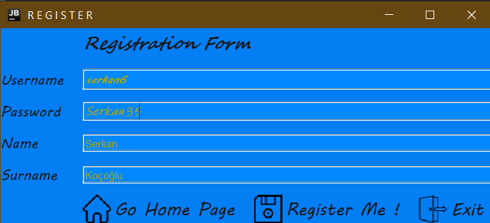
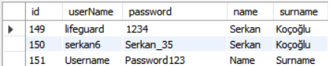
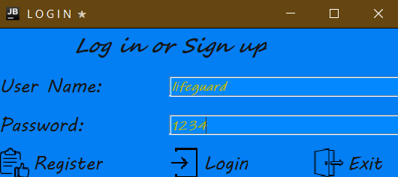
String query = "insert into sekotify.customer (username,password,name,surname) values (?,?,?,?)";
String query = "select userName,password from sekotify.customer where userName='" + username + "' and password='" + password + "' ";
if (rs.next()) { setCurrentCustomerName(username);
return true;
}
Notes:
hi

Slide 3
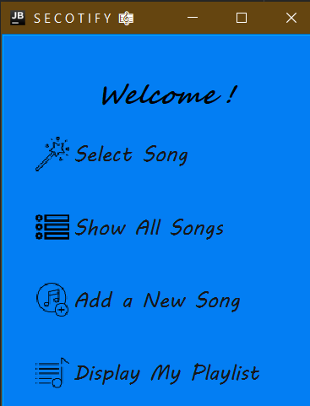

Slide 4
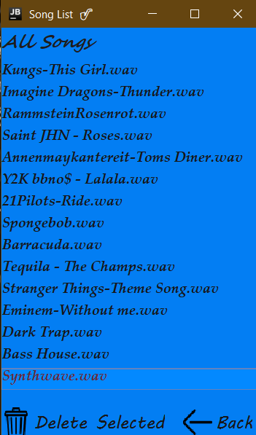
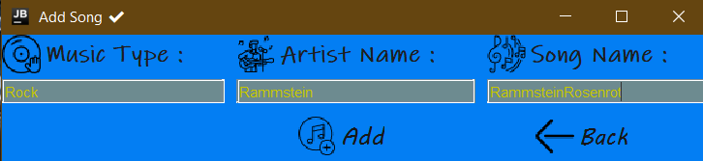
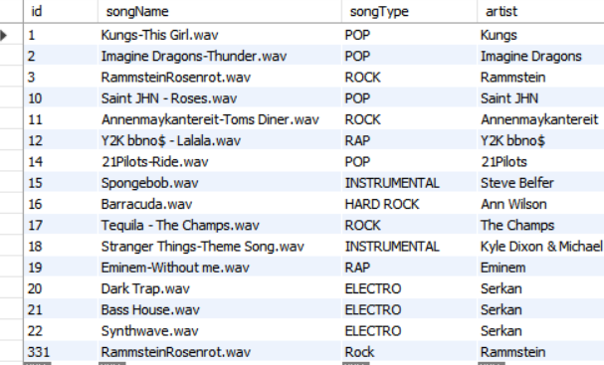
<---

Slide 5

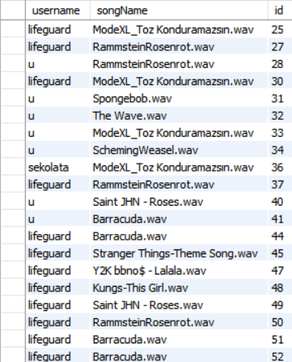
String query = "INSERT INTO `sekotify`.`playlist` (`username`, `songName`) VALUES (" + "'" + CurrUserName + "'" + "," + "'" + sarkiadi + "'" + ");";
prepareStatement("select distinct songName from playlist where username = " + "'" + CurrUserName + "';");

Slide 6
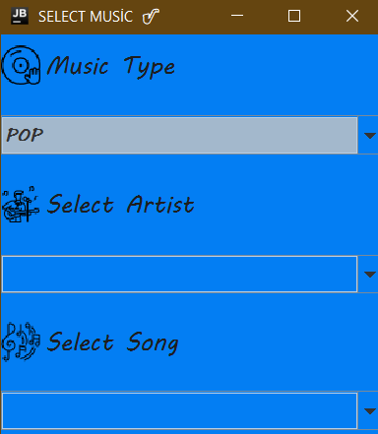
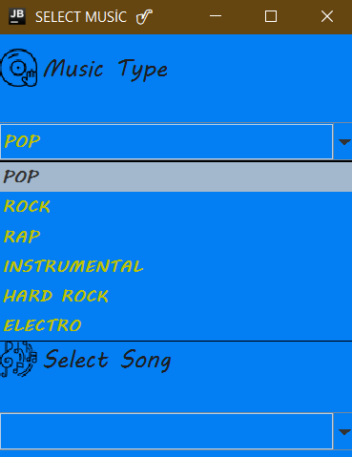
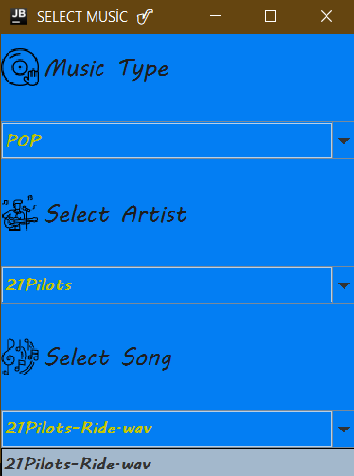
String query = "select distinct songType from sekotify.song ;";
ResultSet rs = st.executeQuery(query);
while (rs.next()) {
type = rs.getString(1);
TypeList.add( type);}

Slide 7
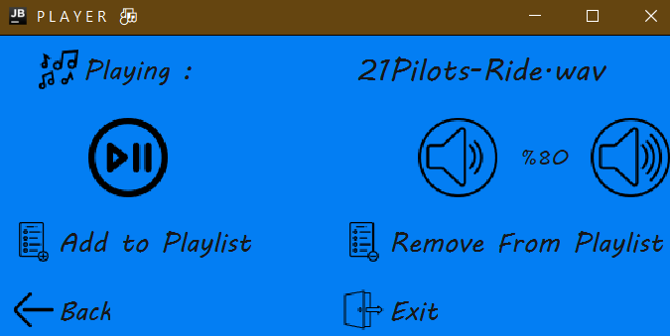
---> music.setText(para);
---> public int getVolume() {
int result = 2*(int)(volume+45);
return result; }
if (Play) {
u.Pause();
play_pause.setEnabled(false);
Play = false;
} else {
u.Play(para);
play_pause.setEnabled(true);
Play = true;
}
String query = "INSERT INTO `sekotify`.`playlist` (`username`, `songName`) VALUES (" + "'" + CurrUserName + "'" + "," + "'" + sarkiadi + "'" + ");";
String query = "DELETE FROM sekotify.playlist WHERE songName = '" + sarkiadi + "' " + "and username = " + "'" + CurrUserName + "';";

Slide 8

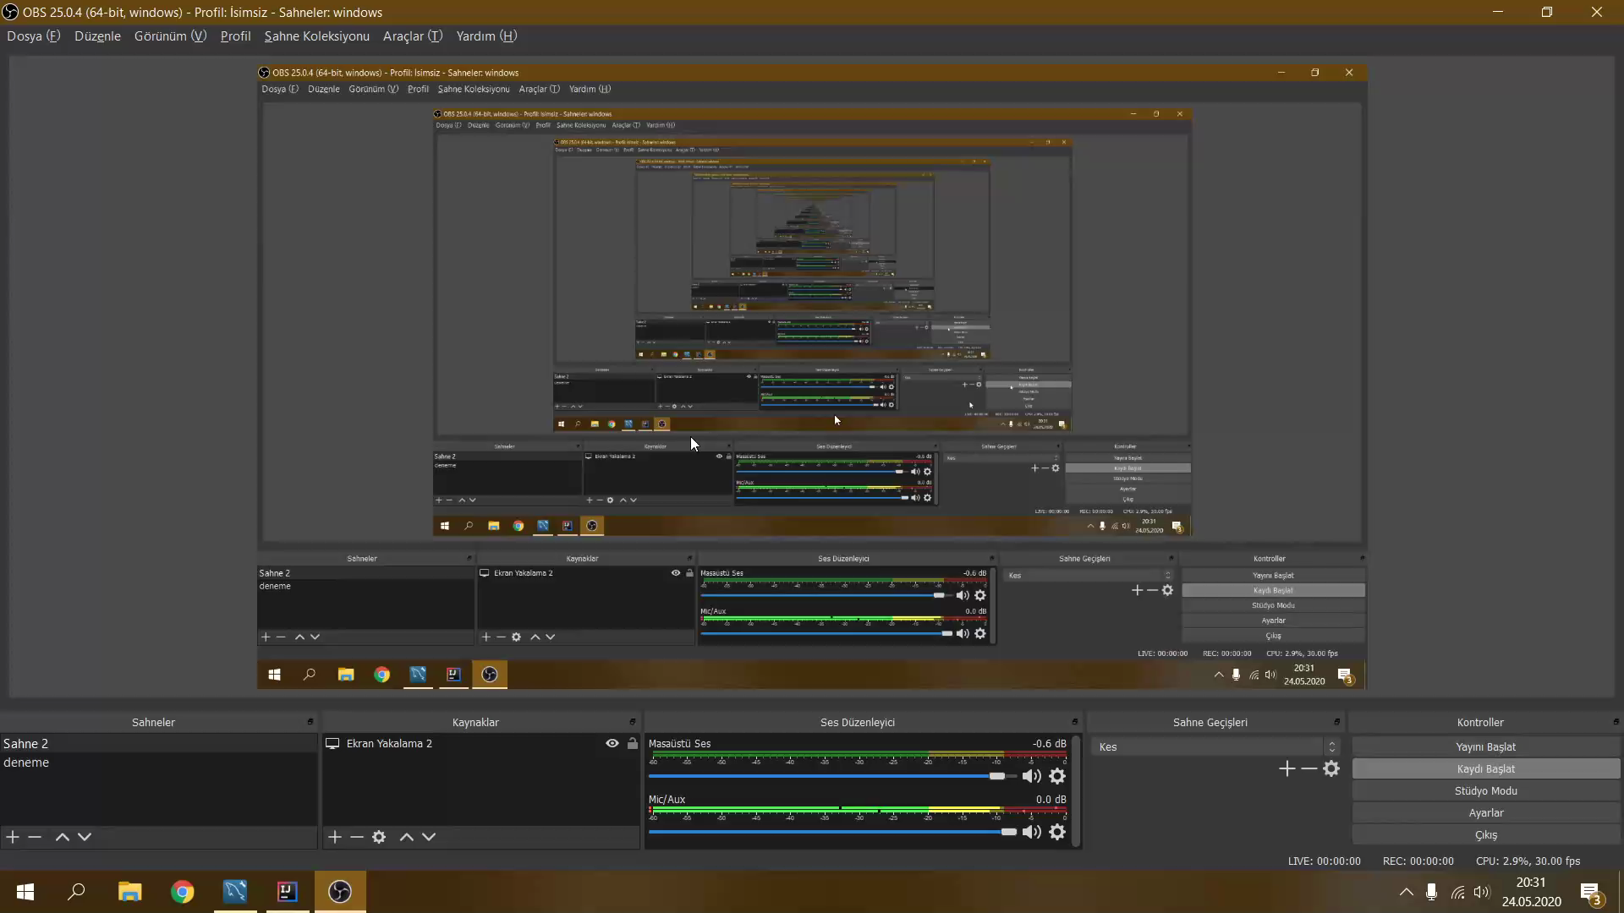
Video Guide

Slide 9
Thank you for your time and consideration
Serkan Koçoğlu
SECOTIFY Project Presentation

